Slide 1
British and american
system of government

Slide 2
Kind of political system
Great britain
The usa
a constitutional
monarchy
a federal republic

Slide 3
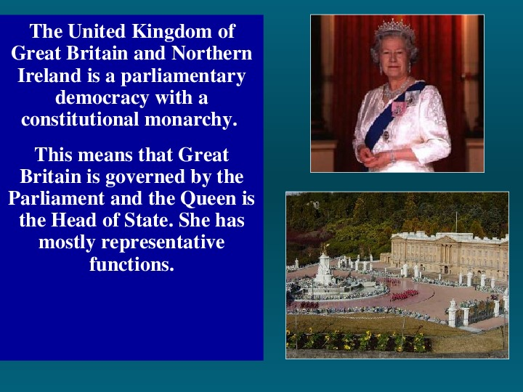
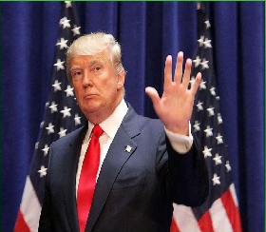
The head of the state
Great britain
The usa
the Queen
the President

Slide 4
How is power organised?
Great britain
The usa
legislative,
executive,
judicial
legislative,
executive,
judicial

Slide 5
Main law
Great britain
The usa
the Constitution
(unwritten)
the Constitution

Slide 6
Executive power
Great britain
The usa
the Prime Minister
and
his cabinet
the President
and
his cabinet

Slide 7
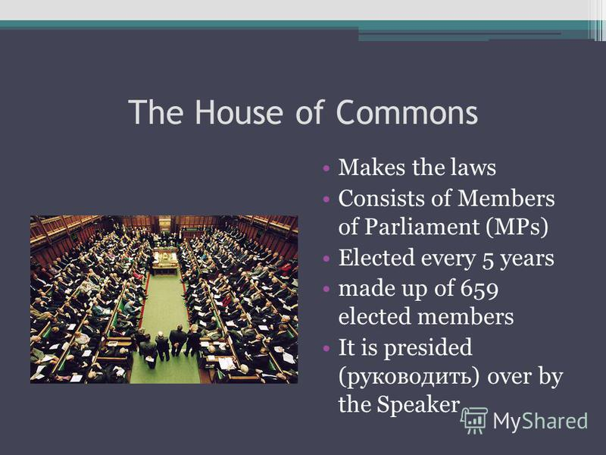
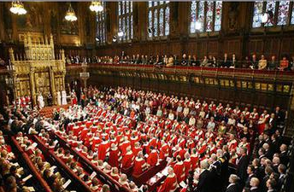
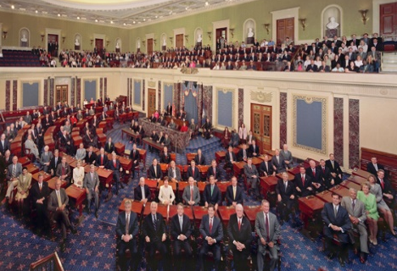
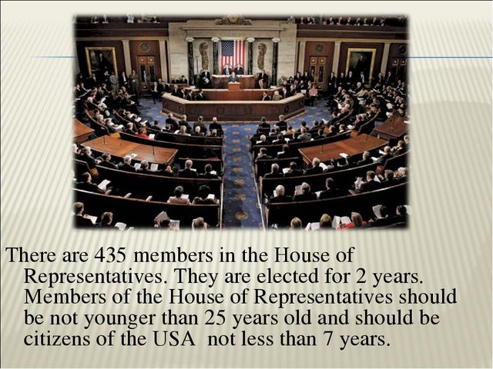
Legislative power
Great britain
The usa
the Houses of
Parliament
the House of the House of
Commons Lords
Commons
the Congress
the Senate the House of
Representatives
Representatives

Slide 8
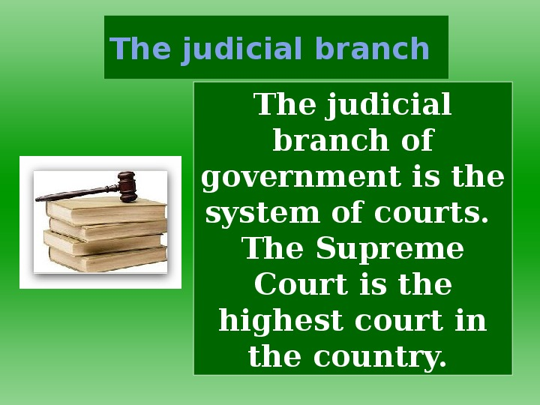
judicial power
Great britain
The usa
the system of courts
the system of courts

Slide 9
elections
Great britain
The usa

Slide 10
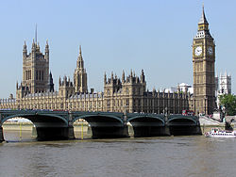
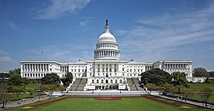
Place of parliamentary sittings
Great britain
The usa
Westminster Palace
United States Capitol

Slide 11
Questions at parliamentary sittings
domestic and foreign policy issues,
important social and political affairs,
consideration of public bills

Slide 12
Questions at
Great britain
The usa
domestic and foreign policy issues, important social and political affairs,
consideration of public bills

Slide 13
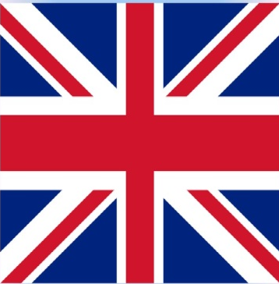
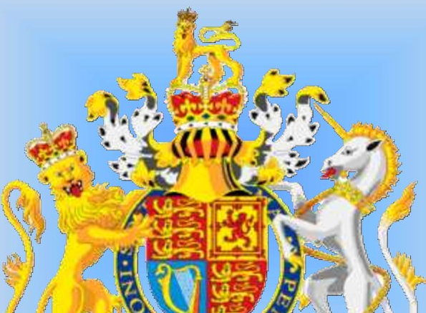
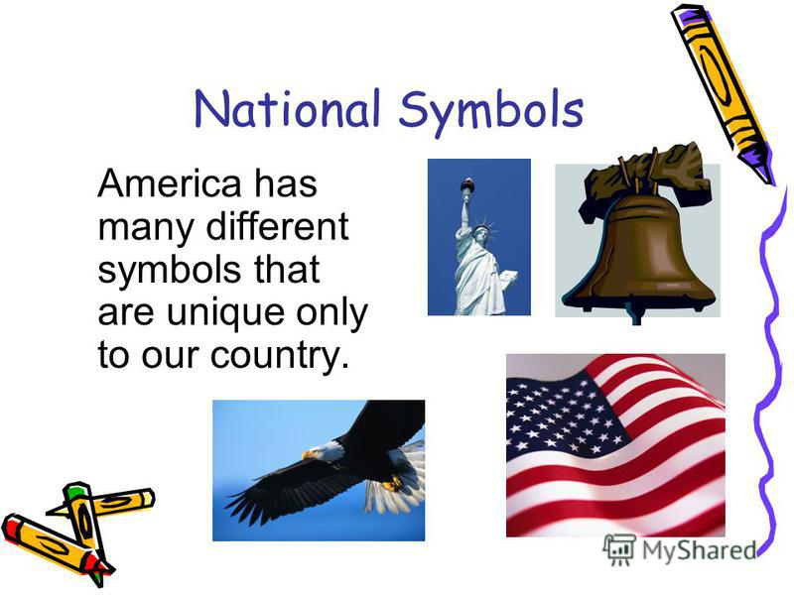
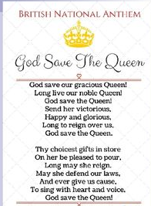
National symbols
Great britain
The usa

Slide 14
Political parties
Great britain
The usa
the Conservative Party
the Labour Party
the Liberal Party
the Democrats
and
the Republicans

Slide 15
